Slide 1
Vehicle Number Plate Detector
User Manual
Author : Aryan Habbu

Slide 2
Table of Contents
Acknowledgements
Introduction
My Internship Journey with Clevered
About App
How do I use the App?
Option Name
Contact Person

Slide 3
Acknowledgements
This is a small vote of thanks to my : Dad who introduced me to Clevered and its AI courses, Mom who supported and helped me throughout my journey and lastly my mentor Mr. Avishek who has guided me through this journey and helped me with any doubts that I had. I would also like to thank Dr. Ken for initiating this internship and giving people this great opportunity for learning about AI.

Slide 4

Introduction
I am Aryan Rajendra Habbu. I am from Karnataka, India but I live in Dubai, UAE. I am 13 years old. I study at Cambridge International School (CIS). My hobbies are Football, Drawing, Reading, Swimming, Cricket and playing Video Games. My favorite color is blue.

Slide 5
My Internship Journey with Clevered
My experience with Clevered till now has been amazing and I am extremely happy that I have done courses with Clevered. Before I joined Clevered, I used to find AI extremely difficult and didn’t enjoy it but after I started exploring the program with Clevered I started to enjoy it immensely. Overall I am very happy that I got the opportunity to learn AI from Clevered. I have also recommended Clevered to my friend who was interested in learning about AI and how to use it.

Slide 6
About App
My app is designed to detect number plates of various vehicles. A car number plate detector benefits the society in numerous ways. It helps by identifying vehicles involved in regulatory violations and unethical activities, thereby helping to maintain law and order. It assists the authorities in locating stolen vehicles and monitoring traffic violations, ensuring vehicles adhere to registration and safety measures. Furthermore, it enhances the efficiency of parking and toll collection, saving both time and resources. Additionally, my app is user-friendly, easy to use, and operates very quickly.

Slide 7
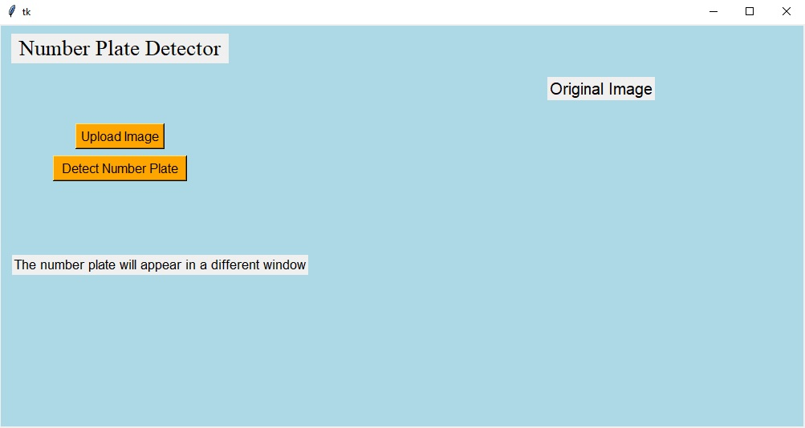
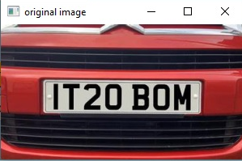
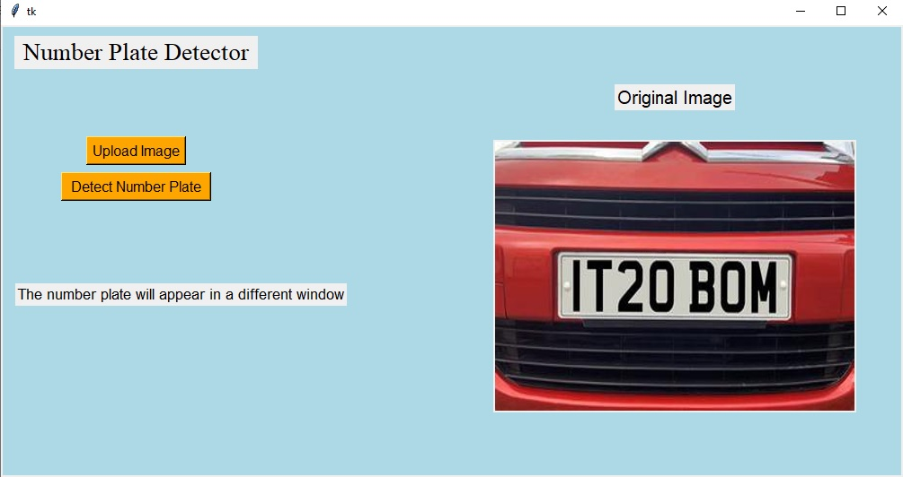
How do I use the app ?
Using the app is straightforward and involves two simple steps:
Upload Your Image : Click the "Upload Your Image" button. This will open the file explorer on your laptop or the photos app on your mobile device. Select the image you want to use for number plate detection and upload it.
Detect Number Plate : After uploading your image, click the "Detect Number Plate" button. The app will process your image and display a series of images including: the original image, a grayscale version, a smoothed version, an edged version, an image with contours, the top 30 contours in the image, the detected license plate, and finally, a cropped image showing only the number plate.
1

Slide 8
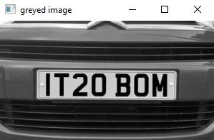
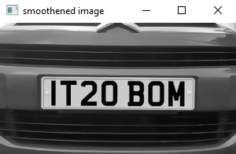
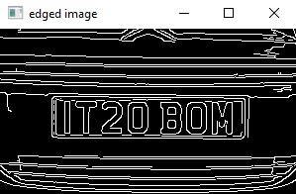
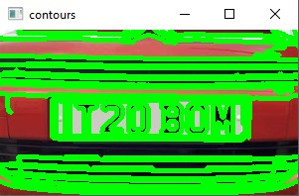
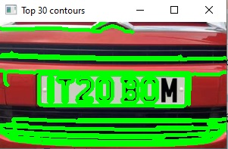
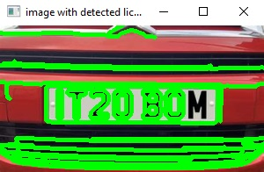

2
3
4
5
6
7
8

Slide 9
Option Name
Upload Image button to upload you desired image for the program to work on.
Detect Number Plate button to run the program on the uploaded image.

Slide 10
Contact Person
If you encounter any issues while using the app, please contact me at:
habbuaryan@gmail.com

Slide 11
Thank You

